Slide 1
Achieving Data Sovereignty for EU-Enterprises through European Cloud Infrastruture
Master‘s Thesis
Ihonosetale Oseghale
Master of Engineering (M.Eng.)
Notes:
Ihonosetale Oseghale – Alps. Alpine Europe GmBH – Technische Hochschule Rosenheim

Slide 2
Research Design: Five Studies
Sovereignty Scoring
Can they legally protect our data ?
Providers Capability Gap Analysis wrt AWS
Can they do what AWS does ?
Financial Viability & Investments
Will they still exist in 5years ?
Technical Benchmarking and pricing
Are they fast enough, at what cost ?
Build Feasibility
What would it take to build it ourselves ?
Notes:
Ihonosetale Oseghale – Alps. Alpine Europe GmBH – Technische Hochschule Rosenheim

Slide 3
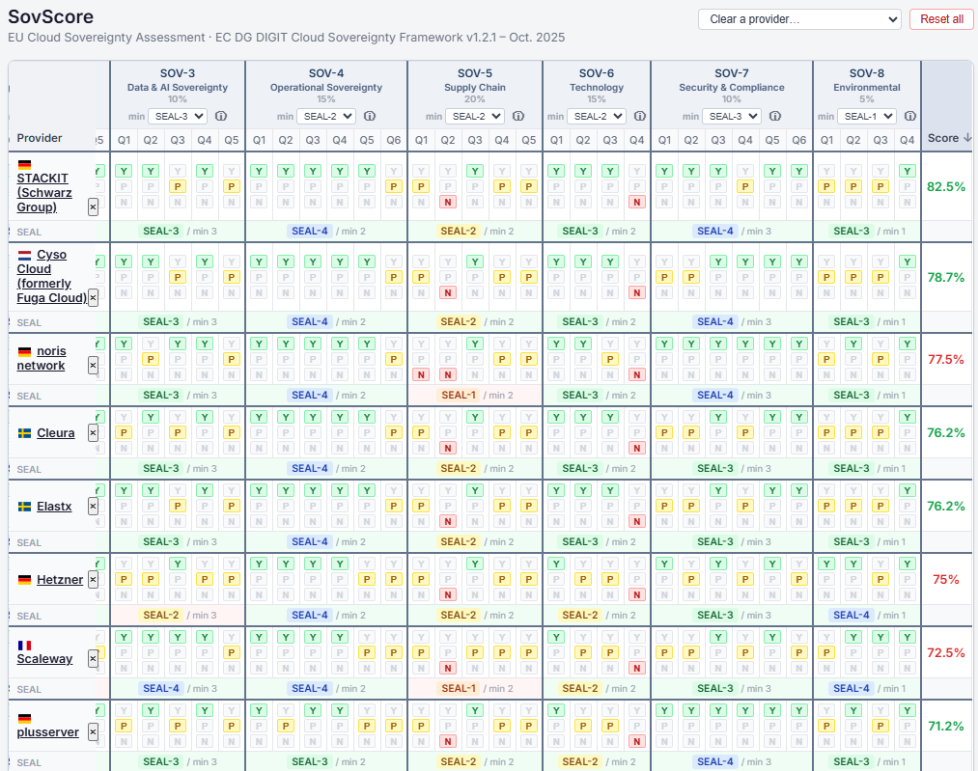
Sovereignty Scoring
EU DG DIGIT SOV - Cloud Sovereignty Framework
Notes:
Ihonosetale Oseghale – Alps. Alpine Europe GmBH – Technische Hochschule Rosenheim

Slide 4
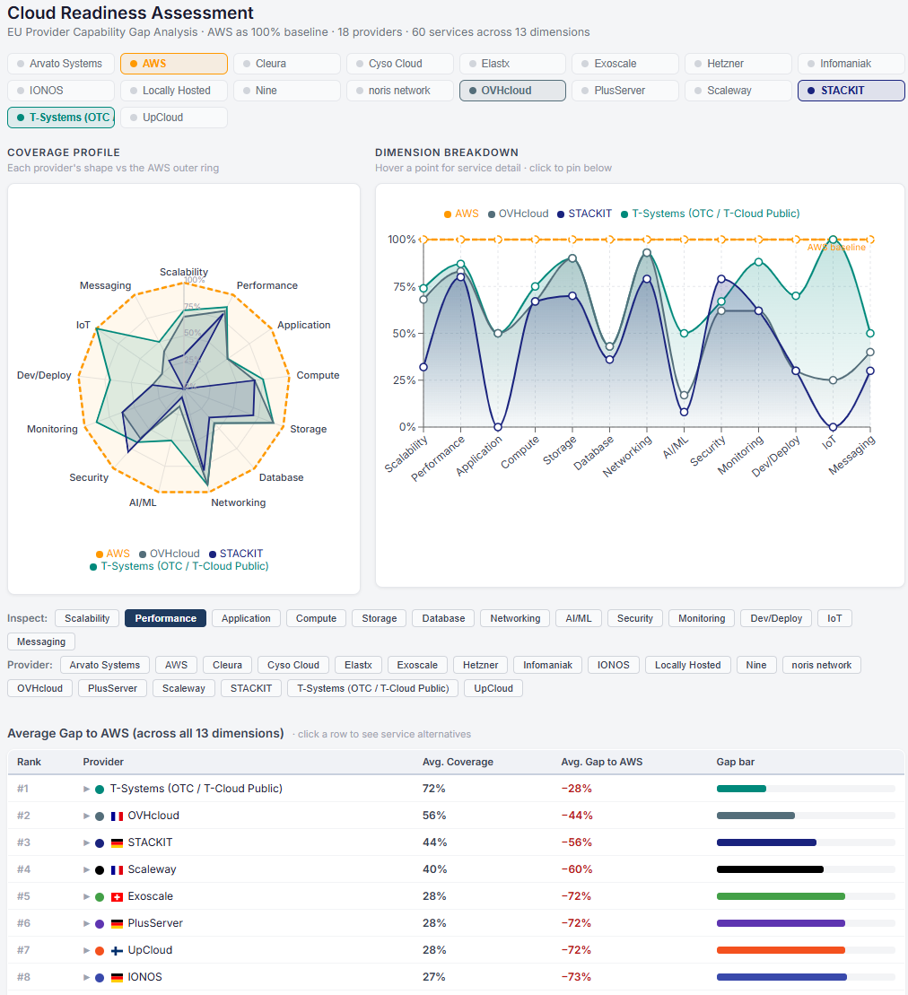
Capability Evaluation & Gap from AWS
Cloud Readiness Assessment
Notes:
Ihonosetale Oseghale – Alps. Alpine Europe GmBH – Technische Hochschule Rosenheim

Slide 5
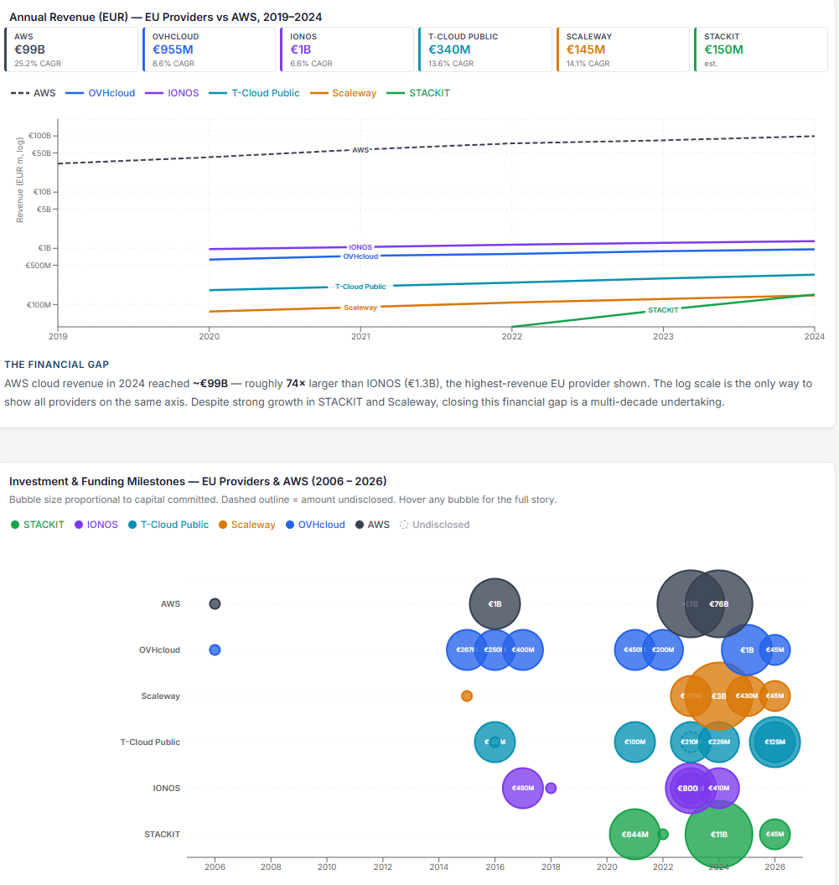
Financial Viability & Investments
Historical Growth & Projected Parity with AWS
Notes:
Ihonosetale Oseghale – Alps. Alpine Europe GmBH – Technische Hochschule Rosenheim

Slide 6
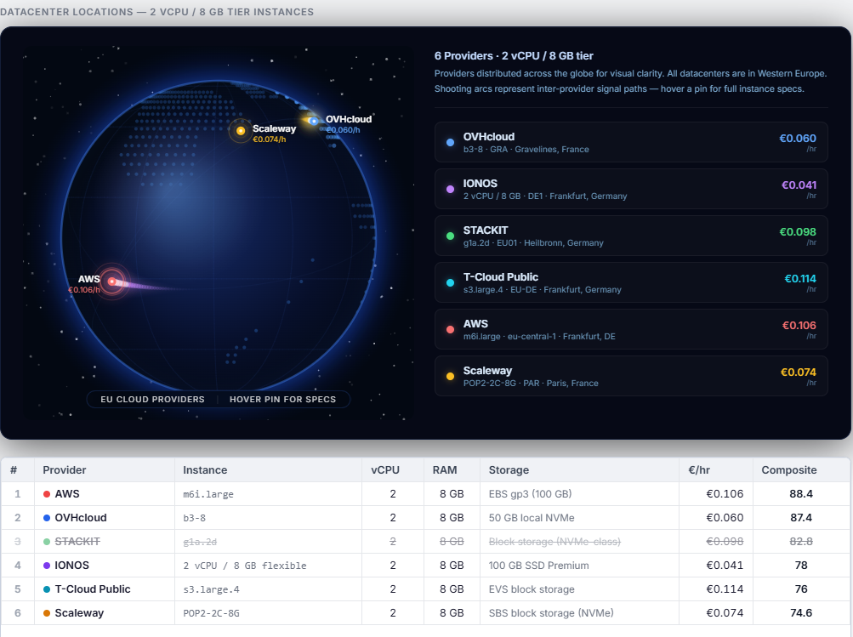
Technical benchmarking, Performance & pricing
2 vCPU / 8 GB tier instances
Notes:
Ihonosetale Oseghale – Alps. Alpine Europe GmBH – Technische Hochschule Rosenheim

Slide 7
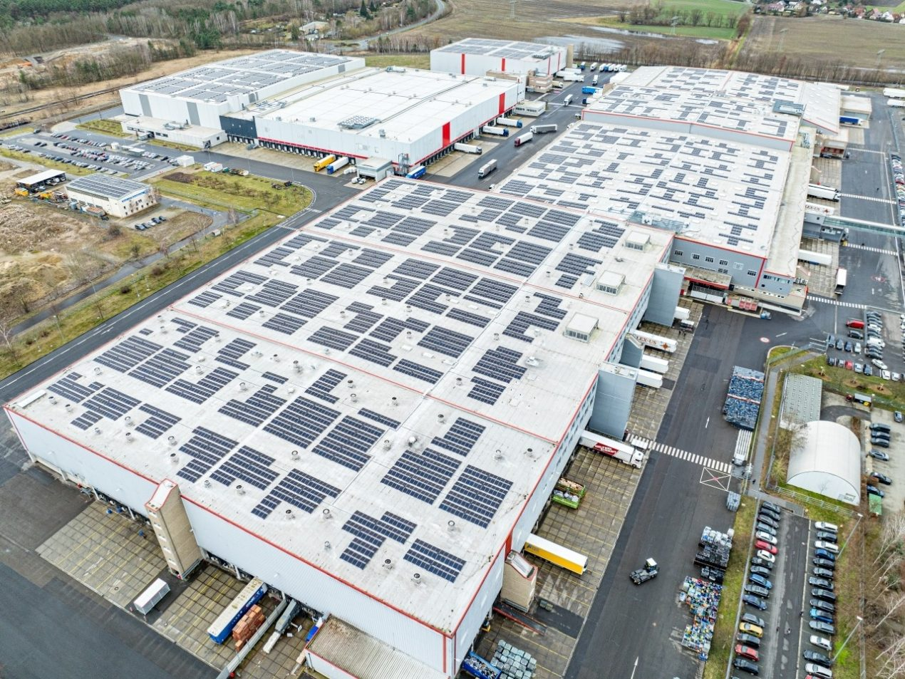
Building a Sovereign Cloud Infrastruture
Expanding „Locally hosted“ From a Business Perspektive
Technical know-how
Skill set & Trainings
Open source
Cloud Architecture layer
schwarz-digits-datacenter-luebbenau
Notes:
Ihonosetale Oseghale – Alps. Alpine Europe GmBH – Technische Hochschule Rosenheim

Slide 8
Thesis Draft
Master Thesis best practices - LPD System Validation – Confluence
Ch. 4 (Provider Evaluation -- Exp 1–4) — discussing the data from the experiments
Ch. 3 (Methodology)
Ch. 5 (Build: Feasibility of Own Infrastructure) — the Canonical notes are effectively a first draft already
Ch. 2 (Foundations) — most citation-heavy chapter, the bigger workload on the legal section
Ch. 6, 7, 8 (Synthesis, Discussion, Conclusion)
Ch. 1 (Introduction) — last. Because I can only introduce a thesis that I have finished.
Notes:
Ihonosetale Oseghale – Alps. Alpine Europe GmBH – Technische Hochschule Rosenheim

Slide 9
Deployment ????
Gillam et. al
pts/stream
pts/hint
pts/compress-7zip
pts/postmark
pts/apache
iperf3
Notes:
Ihonosetale Oseghale – Alps. Alpine Europe GmBH – Technische Hochschule Rosenheim

